Slide 1


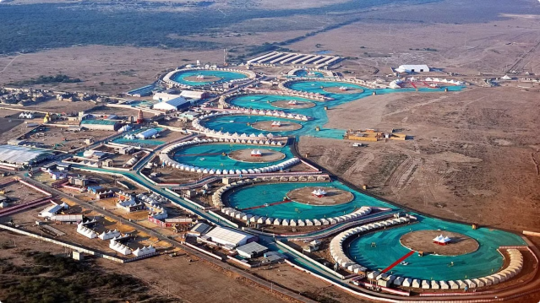
Discover the Charm of Dhordo Village

Slide 2

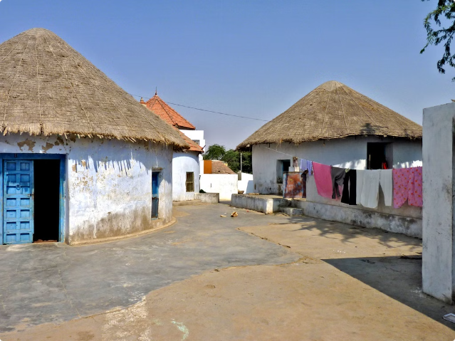
The Vibrant Village of Dhordo
Located in the Rann of Kutch region of Gujarat, Dhordo is a picturesque village known for its unique mud houses, colorful culture, and warm hospitality. With a population of around 1,500 people, this rural settlement offers a glimpse into the traditional way of life in India.

Slide 3

Reaching the Hidden Gem
By Road
1
Dhordo is easily accessible by road, situated just 80 km from Bhuj, the nearest major city. Hire a cab or take a bus to enjoy the scenic drive through the Rann of Kutch.
2
By Air
The closest airport is in Bhuj, about 90 minutes away from Dhordo. From there, you can take a taxi or join a guided tour to reach the village.
By Train
3
The nearest railway station is in Bhuj, from where you can take a bus or taxi to Dhordo, which is about a 2-hour journey.

Slide 4
Where to Stay in Dhordo
Mud Huts
Tents
Resorts
Experience the traditional way of life by staying in one of the charming mud huts known as 'Bhungas'. These unique dwellings offer a cozy and authentic experience.
For a more adventurous stay, opt for the glamping tents set up in the village, providing a comfortable and immersive experience in the heart of the Rann of Kutch.
Nearby resorts offer modern amenities and a luxurious stay while still allowing you to explore the local culture and attractions.

Slide 5

Embracing the Rural Charm
1
Explore the Vibrant Crafts
2
Witness the Rann Utsav
3
Venture into the Salt Marsh
Dhordo is known for its rich tradition of handmade crafts, including intricate embroidery, pottery, and weaving. Witness artisans at work and even participate in workshops.
Attend the annual Rann Utsav, a renowned festival that celebrates the culture and heritage of the Rann of Kutch region through music, dance, and local delicacies.
Take a guided tour to explore the vast Rann of Kutch, a stunning salt marsh that transforms into a white desert during the dry season.

Slide 6

Thank You

